Slide 1
9 Memory Hierarchy
Up to now…
Reality…
Processors have cycle times of ~1 ns
Fast DRAM has a cycle time of ~100 ns
We have to bridge this gap for pipelining to be effective!
Black Box
MEMORY

Slide 2
9 Memory Hierarchy
Clearly fast memory is possible
Register files made of flip flops operate at processor speeds
Such memory is Static RAM (SRAM)
Tradeoff
SRAM is fast
Economically unfeasible for large memories

Slide 3
9 Memory Hierarchy
SRAM - Cache
High power consumption
Costly per bit
DRAM - Main Memory - RAM
Low power consumption
Small size
Ideal for large memories

Slide 4
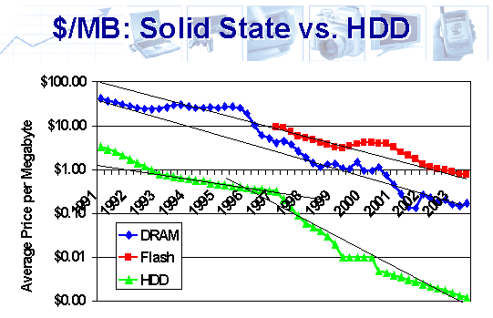
9 Memory Hierarchy
Source: http://www.storagesearch.com/semico-art1.html

Slide 5
9.1 The Concept of a Cache
Feasible to have small amount of fast memory and/or large amount of slow memory.
Want
Size advantage of DRAM
Speed advantage of SRAM.
Increasing speed as we get closer to the processor
Increasing size as we get farther away from the processor
CPU looks in cache for data it seeks from main memory.
If data not there it retrieves it from main memory.
If the cache is able to service "most" CPU requests then effectively we will get speed advantage of cache.
All addresses in cache are also in memory
CPU
Cache
Main memory

Slide 6
9.2 Principle of Locality
A program tends to access a relatively small region of memory irrespective of its actual memory footprint in any given interval of time. While the region of activity may change over time, such changes are gradual

Slide 7
9.2 Principle of Locality
Spatial Locality: Tendency for locations close to a location that has been accessed to also be accessed
Temporal Locality: Tendency for a location that has been accessed to be accessed again
Example
for(i=0; i<100000; i++)
a[i] = b[i];

Slide 8
9.3 Basic terminologies
Hit: CPU finding contents of memory address in cache
Hit rate (h) is probability of successful lookup in cache by CPU.
Miss: CPU failing to find what it wants in cache (incurs trip to deeper levels of memory hierarchy
Miss rate (m) is probability of missing in cache and is equal to 1-h.
Miss penalty: Time penalty associated with servicing a miss at any particular level of memory hierarchy
Effective Memory Access Time (EMAT): Effective access time experienced by the CPU when accessing memory.
Time to lookup cache to see if memory location is already there
Upon cache miss, time to go to deeper levels of memory hierarchy
EMAT = Tc + m * Tm
where m is cache miss rate, Tc the cache access time and Tm the miss penalty

Slide 9
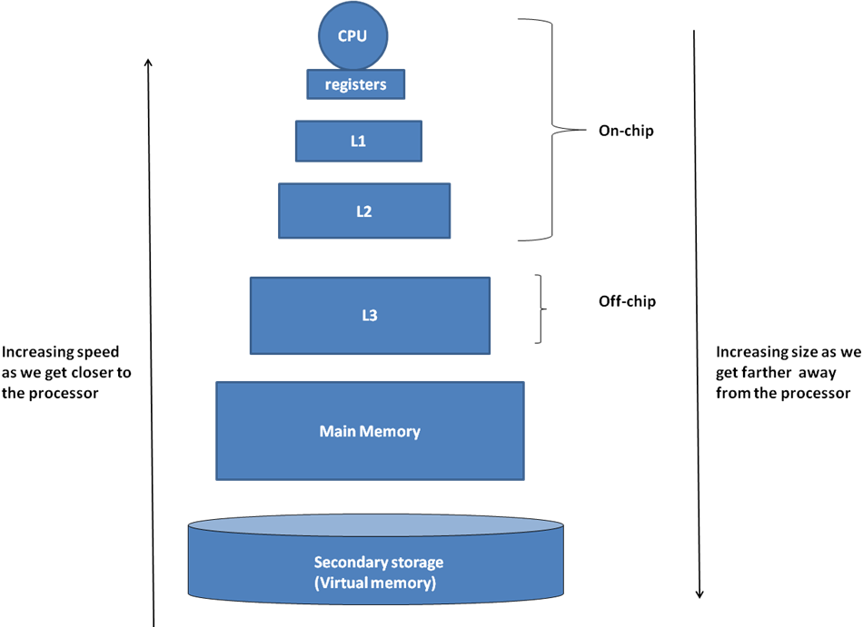
9.4 Multilevel Memory Hierarchy

Slide 10
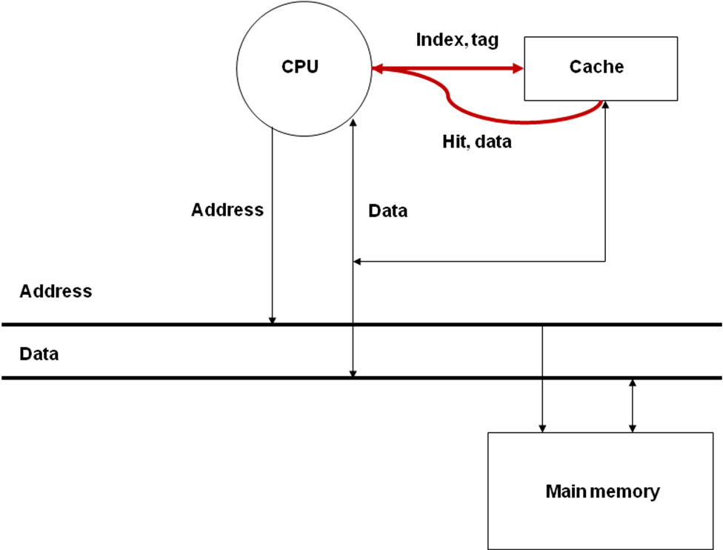
9.8 Cache read/write algorithms
Read Hit

Slide 11
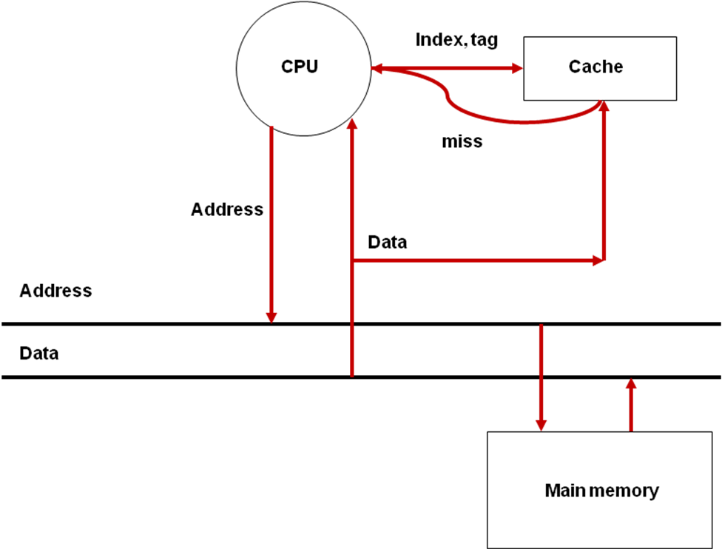
9.8 Basic cache read/write algorithms
Read Miss

Slide 12
9.5 Cache organization
There are three facets to the organization of the cache:
Placement: Where do we place in the cache the data read from the memory?
Algorithm for lookup: How do we find something that we have placed in the cache?
Validity: How do we know if the data in the cache is valid?

Slide 13
Types of Cache
There is three types of cache:
direct-mapped cache;
fully associative cache;
N-way-set-associative cache.

Slide 14
9.6 Direct-mapped cache organization
0
1
Cache
2
3
0
4
1
5
2
6
3
7
4
8
5
9
6
10
7
11
12
13
14
15
In direct-mapped cache cache memory location maps to a single cache line. It can be used once per address per amount of time. Performance of this cache memory type is lower than others.

Slide 15
9.11.1 Fully associative cache
In a fully associative cache every memory location can be cached in any cache line. This memory type significantly decreases amount of cache-line misses, considered as complex type of cache memory implementation.

Slide 16
In N-way-set-associative cache, the most common cache implementation, memory address can be stored in any N lines of cache.

Slide 17
9.11.2 Set associative caches
VTag
Data
VTag
Data
Two-way Set
Associative
VTag
Data
VTag
Data
VTag
Data
VTag
Data
VTag
Data
VTag
Data
VTag
Data
VTag
Data
Four-way Set
Associative
VTag
Data
VTag
Data
VTag
Data
VTag
Data
VTag
Data
VTag
Data
Direct
Mapped
(1-way)
VTag
Data
VTag
Data
VTag
Data
VTag
Data
VTag
Data
VTag
Data
VTag
Data
VTag
Data
Fully
Associative
(8-way)
VTag
Data
VTag
Data
VTag
Data
VTag
Data
VTag
Data
VTag
Data
VTag
Data
VTag
Data

Slide 18
9.11.2 Set associative caches
Assume we have a computer with 16 bit addresses and 64 Kb of memory
Further assume cache blocks are 16 bytes long and we have 128 bytes available
for cache data
Cache Type | Cache Lines | Ways | Tag | Index bits | Block Offset (bits)
Direct Mapped | 8 | 1 | 9 | 3 | 4
Two-way Set Associative | 4 | 2 | 10 | 2 | 4
Four-way Set Associative | 2 | 4 | 11 | 1 | 4
Fully Associative | 1 | 8 | 12 | 0 | 4

Slide 19
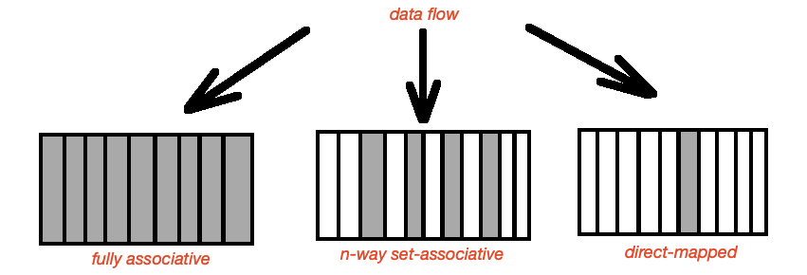

Slide 20
9.13 Reducing miss penalty
Reducing the miss penalty is desirable
It cannot be reduced enough just by making the block size larger due to diminishing returns
Bus Cycle Time: Time for each data transfer between memory and processor
Memory Bandwidth: Amount of data transferred in each cycle between memory and processor

Slide 21
9.14 Cache replacement policy
An LRU policy is best when deciding which of the multiple "ways" to evict upon a cache miss
Type Cache | Bits to record LRU
Direct Mapped | N/A
2-Way | 1 bit/line
4-Way | ? bits/line
When accessing cache memory processor realises that all cache line are valid, then least recently used algorithm (LRU) starts. Data, that was not accessed longest time is replaced with new data.

Slide 22
9.22 Performance implications of memory hierarchy
Type of Memory | Typical Size | Approximate latency in CPU clock cycles to read one word of 4 bytes
CPU registers | 8 to 32 | Usually immediate access (0-1 clock cycles)
L1 Cache | 32 (Kilobyte) KB to 128 KB | 3 clock cycles
L2 Cache | 128 KB to 4 Megabyte (MB) | 10 clock cycles
Main (Physical) Memory | 256 MB to 4 Gigabyte (GB) | 100 clock cycles
Virtual Memory (on disk) | 1 GB to 1 Terabyte (TB) | 1000 to 10,000 clock cycles (not accounting for the software overhead of handling page faults)

Slide 23
9.23 Summary
Category | Vocabulary | Details
Principle of locality (Section 9.2) | Spatial | Access to contiguous memory locations
 | Temporal | Reuse of memory locations already accessed
Cache organization | Direct-mapped | One-to-one mapping (Section 9.6)
 | Fully associative | One-to-any mapping (Section 9.12.1)
 | Set associative | One-to-many mapping (Section 9.12.2)
Cache reading/writing (Section 9.8) | Read hit/Write hit | Memory location being accessed by the CPU is present in the cache
 | Read miss/Write miss | Memory location being accessed by the CPU is not present in the cache

Slide 24
9.23 Summary
Category | Vocabulary | Details
Cache parameters | Total cache size (S) | Total data size of cache in bytes
 | Block Size (B) | Size of contiguous data in one data block
 | Cache access time | Time in CPU clock cycles to check hit/miss in cache
 | Miss penalty | Time in CPU clock cycles to handle a cache miss

Slide 25
9.23 Summary
Category | Vocabulary | Details
Performance metrics | Hit rate (h) | Percentage of CPU accesses served from the cache
 | Miss rate (m) | 1 – h
Types of misses | Compulsory miss | Memory location accessed for the first time by CPU
Replacement policy - Algorithms | FIFO | First in first out
 | LRU | Least recently used
Memory technologies | SRAM | Static RAM with each bit realized using a flip flop
 | DRAM | Dynamic RAM with each bit realized using a capacitive charge
Main memory | DRAM access time | DRAM read access time
 | DRAM cycle time | DRAM read and refresh time
 | Bus cycle time | Data transfer time between CPU and memory

Slide 26
9.24 Memory hierarchy of modern processors – An example
AMD Barcelona chip (circa 2006). Quad-core.
Per core L1 (split I and D)
2-way set-associative (64 KB for instructions and 64 KB for data).
L2 cache.
16-way set-associative (512 KB combined for instructions and data).
L3 cache that is shared by all the cores.
32-way set-associative (2 MB shared among all the cores).

Slide 27
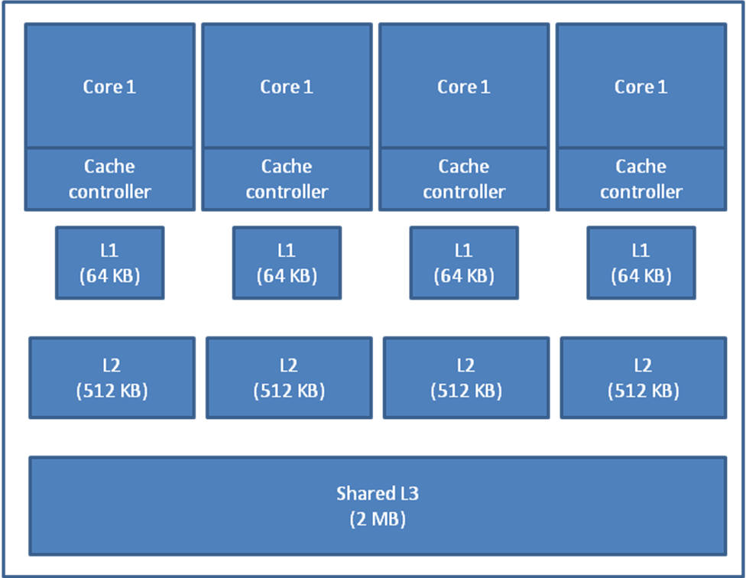
9.24 Memory hierarchy of modern processors – An example

